Slide 1
OpenCL Project
Final-term report
陈坚达 陈上宇 陈胜杰 陈秋良 谷枫 柯柳
2015.6.24

Slide 2
Content
Where to do parallelization
How to do parallelization
What results
Conclusion
Future work

Slide 3
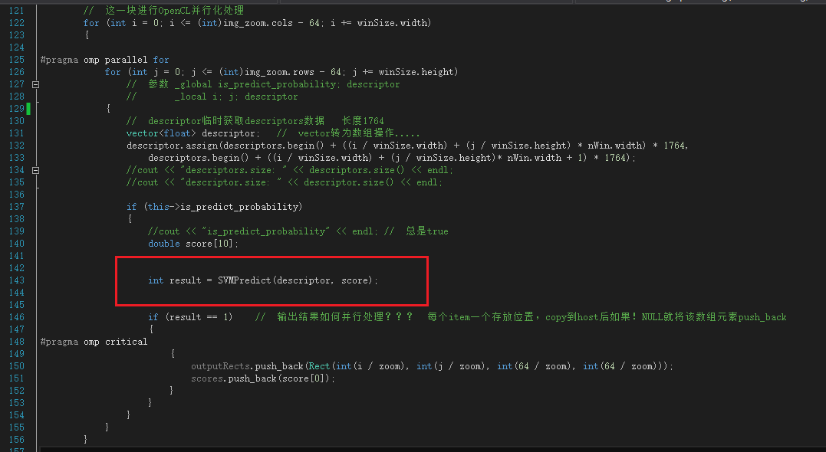
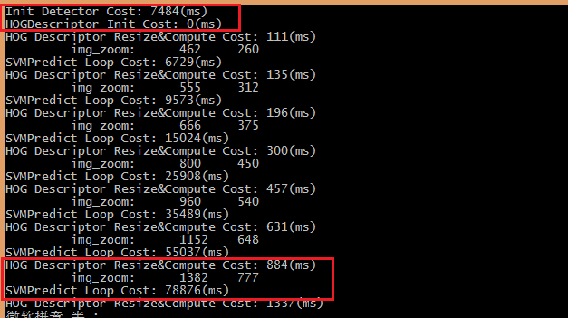
Where to do parallelism

Slide 4
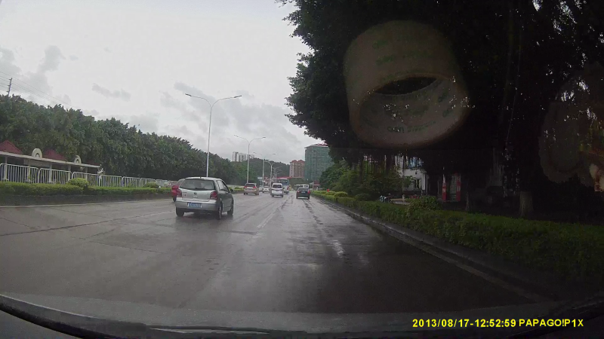
How to do parallelism

Slide 5
How to do parallelism
descriptors
……
descriptor0
descriptork

Slide 6
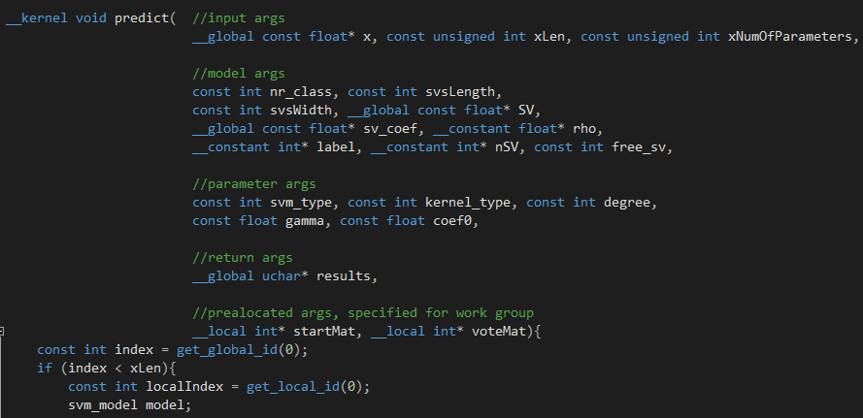
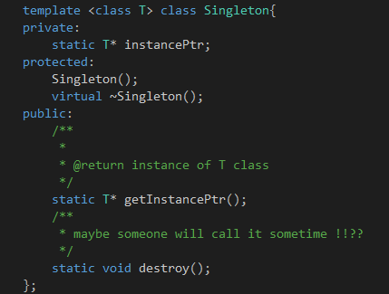
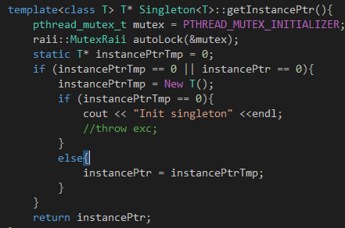
Libsvm opencl移植
SingleItem
Pthread mutex
Global memory

Slide 7
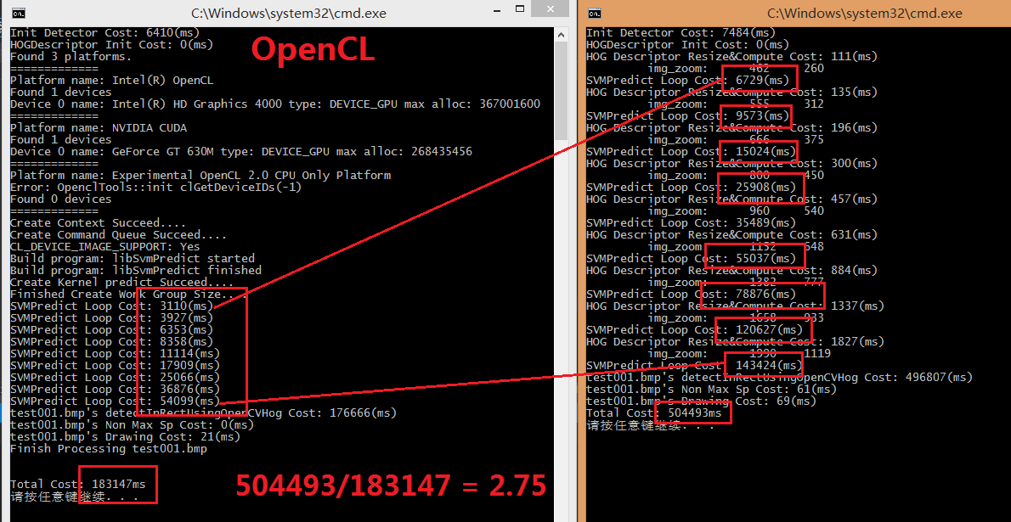
What results

Slide 8
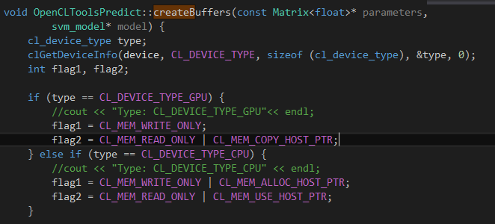
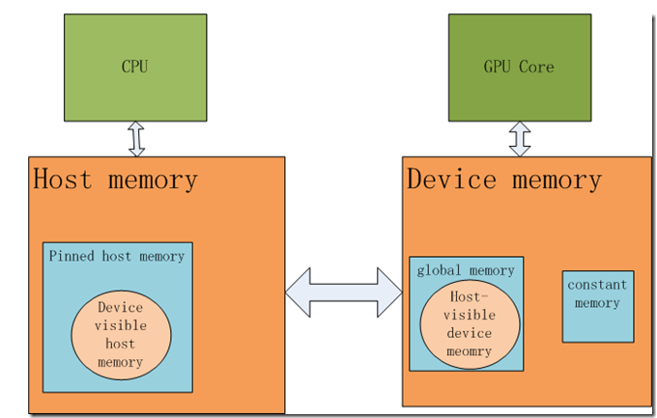

Slide 9
conclusion
We worked hard, and finally made it.
Group work is REALLY IMPORTANT.
Using Github to control code version
Opencl is useful, powerful, but not easy to use
Not support calling other function
Not support some c function
Platform related, like double, Intel GPU not support

Slide 10
Future work
The result is not so good as CPU version
  considering probability
Off-line compiling
Code refactor

Slide 11
Thank you

